Slide 1
Computational Complexity

Slide 2
Machine (Computer)
Complexity
Language
Mathematical Logic

Slide 3
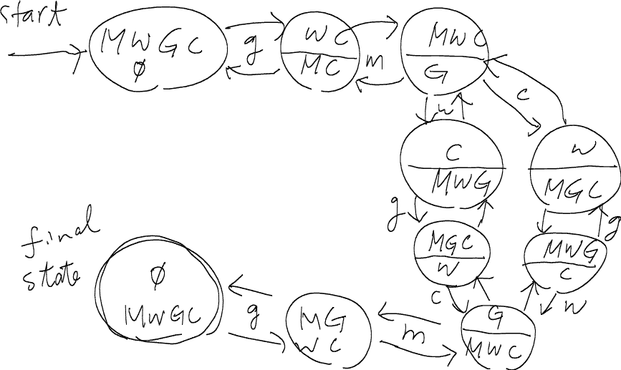
Missionary, Wolf, Goat, Cabbage

Slide 4
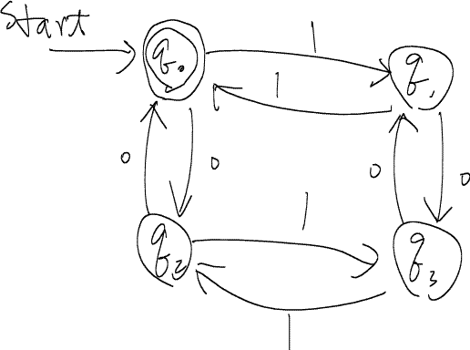
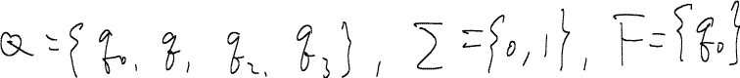
Finite-State Automata
Q is a set of states
Σ is an input alphabet
δ is a transition function
F is a set of final states

Slide 5
Finite-State Automata
A string x is said to be accepted (recognized) by a finite state machine M = (Q, Σ, δ, q₀, F) if δ(q₀,x)=p for some p in F.
The language is accepted by M, designated by L(M), is the set {x|δ(q₀,x) is in F}
A language can be accepted by a finite state automata is called regular. For example, 00, (0+1)*, (0+1)*00(1+10)*
There are languages that cannot be accepted by FA. For example, 0^{n}1^{n} or w0w^{r}, where w is a string

Slide 6
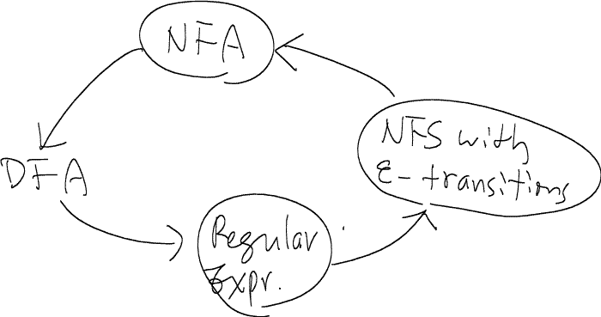
Non-determinism
Upon the input of a single letter, the machine can move to a subset of states
Equivalence

Slide 7
Context-Free Grammars (CFG)
Production rules
<expr> ⇒ <expr> * <expr>
⇒ (<expr>) * <expr>
⇒ (<expr>) * id
⇒ (<expr> + <expr>) * id
⇒ (<expr> + id) * id
⇒ (id + id ) * id

Slide 8
CFG Example:
G = (V, T, P, S), where V = {S, A, B}, T = {a, b}, P = {S → aSb, S → ab}
The language L(G) is the set of all words in T⁺ consisting of an equal number of a’s and b’s
Chomsky Normal Form (CNF)
Any context-free language without ε is generated by a grammar in which all productions are of the form A → BC or A → a.

Slide 9
Pushdown Automaton
Q is a set of states
Σ is an input alphabet
Γ is an stack alphabet
q₀ in Q is the initial state
Z₀ is the start symbol in the stack
δ is a transition function that is a mapping
from Q×(Σ∪{ε})×Γ to Q×Γ∗
F is a set of final states

Slide 10
Equivalence between PDA and CFL
If L is a context-free language, there exists a PDA M such that L = N(M)
If L = N(M) for some PDA M, then L is a context-free language

Slide 11
Languages that are not context-free
{ww| w is in (a+b)*}
{a^{i}b^{j}c^{k|}i<j<k}
…

Slide 12
Hierarchy Theorem
The regular sets are properly contained in the context-free languages
The CFL’s not containing the empty string are properly contained in the context-sensitive languages
The CSL’s are properly contained in the r.e. sets

Slide 13
Will a TM halt on a specific instance?
The language accepted by a TM is said to be recursively enumerable (r.e.)
A subclass of r.e. sets, called recursive sets, are those languages accepted by at least one TM that halts on all inputs

Slide 14
Post Correspondence Problem (PCP)
Instance: two lists A = w₁, w₂, …, w_{k} and B = x₁, x₂, …, x_{k}, of strings over some alphabet Σ.
Question: Is there any sequence of integers i₁, i₂, …, i_{m} with m > 1 such that

Slide 15
This instance has no solution

Slide 16
Solvable/Computable/Decidable Solvability/Computability/Decidability

Slide 17
Algorithm Vs. Program
An algorithm is a computational procedure (a sequence of computational steps) that transforms the input into the output.
A program is the realization of an algorithm via a specific programming language.

Slide 18
Complexity functions with respect to Problem sizes
 | 10 | 10² | 10³ | 10⁴
log₂n | 3.3 | 6.6 | 10 | 13.3
n | 10 | 10² | 10³ | 10⁴
nlog₂n | 0.33x10² | 0.7x10³ | 10⁴ | 1.3x10⁵
n² | 10² | 10⁴ | 10⁶ | 10⁸
2^{n} | 1024 | 1.3x10³⁰ | >10¹⁰⁰ | >10¹⁰⁰
n! | 3x10⁶ | >10¹⁰⁰ | >10¹⁰⁰ | >10¹⁰⁰

Slide 19
Rate of growth of common computing time functions

Slide 20
While some simple questions that are difficult to provide answers to, some sophisticated problems are easy to be resolved!
How can we determine whether or not a problem is difficult?
Develop a polynomial-time algorithm
Design an NP-hardness proof
Unfortunately, sometimes we cannot do either

Slide 21
Measurement
We can use the number of comparisons or movements to measure a sorting algorithm
Usually the time complexity of an algorithm is expressed in terms of the number of primitive steps when the algorithm is executed
The running time required by an algorithm can be expressed in terms of its input size, n, or more precisely the input length

Slide 22
Computing time functions
O(1) < O(log n) < O(n) < O(n log n) < O(n²) < O(n³) < O(2^{n}) < O(n!) < O(n^{n})
exponential algorithm: O(2^{n})
polynomial algorithm
Algorithm A : O(n³), algorithm B : O(n)
Should Algorithm B run faster than A?
Not necessarily !
It could be true only when n is large enough!

Slide 23
Binary search
sorted sequence : (Is 9 included or not?)
1 4 5 7 9 10 12 15
step 1 ↑
step 2 ↑
step 3 ↑
best case: 1 step = O(1)
worst case: (⎣log₂ n⎦+1) steps = O(log n)
average case: O(log n) steps

Slide 24
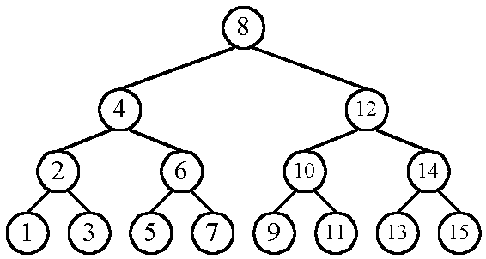
Binary Search Tree
n cases for successful search
n+1 cases for unsuccessful search
Average # of comparisons done in the binary tree:
T(n) = , where k = ⎣log n⎦+1

Slide 25
T(n) =
≈ k as n is very large
= log n
= O(log n)
Is the assumption about n = 2^{k} valid?

Slide 26
Straight selection sort
7 5 1 4 3
1 5 7 4 3
1 3 7 4 5
1 3 4 7 5
1 3 4 5 7
Consider only the number of changes in the flag which is used for selecting the smallest number in each iteration.
best case: O(1)
worst case: O(n²)
average case: O(n log n)

Slide 27
Quick sort
Recursively apply the same procedure.

Slide 28
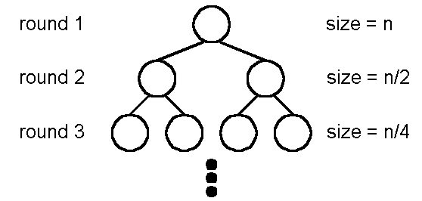
Best case : O(n log n)
A list is split into two sub-lists with almost equal size.
(log n) runs are needed.
In each run, n comparisons (ignoring the element used for splitting the list) are required.

Slide 29
Worst case : O(n²)
In each run, the number used to split is either the smallest or the largest.

Slide 30
Average case: O(n log n)

Slide 33
2D Ranking
Let A = (a₁,a₂), B = (b₁,b₂) on a 2D plane. A is said to dominate B iff a₁> b₁ and a₂ > b₂
Given a set S of n points, the rank of a point is the number of points dominated by this point.
D
B
A
C
E
rank(A)= 0, rank(B) = 1, rank(C) = 1
rank(D) = 3, rank(E) = 0

Slide 34
Straightforward algorithm:
comparing all pairs of points : O(n²)

Slide 35
Divide-and-conquer for finding 2-D ranks
Step 1: Split the points along the median line L into A and B.
Step 2: Find ranks of points in A and ranks of points in B, recursively.
Step 3: Sort points in A and B according to their y-values. Update the ranks of points in B.

Slide 36
Is it possible to improve this part?

Slide 37
Lower bound
A lower bound of a problem is the least time complexity required for any algorithm which can be used to solve this problem.
☆ worst case lower bound
☆ average case lower bound
The lower bound for a problem is not unique.
For example, Ω(1), Ω(n), Ω(n log n) are all lower bounds for sorting.
Ω(1) and Ω(n) are trivial bounds

Slide 38
At present, if the highest lower bound of a problem is Ω(n log n) and the time complexity of the best algorithm is O(n²).
We may try to find a higher lower bound.
We may try to find a better algorithm.
Lower bound of the problem and the algorithm both may be improved.
If the incumbent lower bound is Ω(n log n) and there is an algorithm with time complexity O(n log n), then the algorithm is optimal.

Slide 39
The worst case lower bound of sorting
6 permutations for 3 data elements
a₁ a₂ a₃
1 2 3
1 3 2
2 1 3
2 3 1
3 1 2
3 2 1
In the worst case, any algorithm will take at least 3
comparisons for sorting 3 elements.
In the worst case, any algorithm will take at least 7
comparisons for sorting 5 elements.

Slide 40
Straight insertion sort
input: 7, 5, 1, 4, 3
7
7, 5 → 5, 7
5, 7, 1 → 1, 5, 7
1, 5 ,7, 4 → 1, 4, 5, 7
1, 4, 5, 7, 3 → 1, 3, 4, 5, 7

Slide 41
Straight insertion sort:
input data: (2, 3, 1)
(1) a₁:a₂
(2) a₂:a₃, a₂↔a₃
(3) a₁:a₂, a₁↔a₂
input data: (2, 1, 3)
(1) a₁:a₂, a₁↔a₂
(2) a₂:a₃

Slide 42
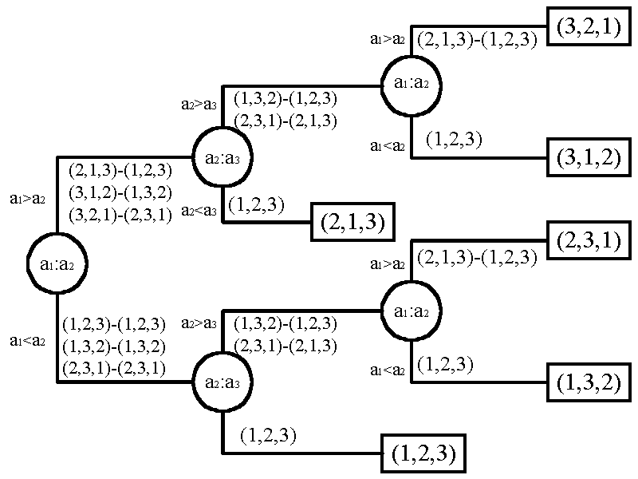
Decision tree for straight insertion sort
6 input sequences

Slide 43
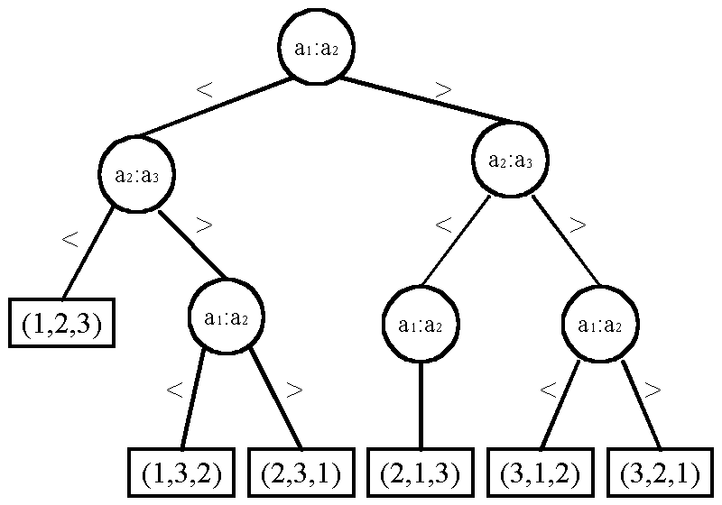
Decision tree for bubble sort
(1, 2, 3) -> (1, 2, 3)
(1, 3, 2) -> (1, 3, 2)
(2, 3, 1) -> (2, 3, 1)
(2, 1, 3) -> (1, 2, 3)
(3, 1, 2) -> (1, 3, 2)
(3, 2, 1) -> (2, 2, 1)
(1, 2, 3) ->
(1, 2, 3)
(1, 3, 2) -> (1, 2, 3)
(2, 3, 1) -> (2, 1, 3)
(2, 1, 3) ->
(1, 2, 3)
(1, 2, 3) -> (1, 2, 3)

Slide 44
Correspondence
A decision tree ←→ a sorting algorithm
A path from the root to a leaf ←→ the operations of the sorting algorithm on a specific input instance
The worst-case running time of a sorting algorithm is the longest path(s) in the tree of that algorithm for some specific instance(s)
Numerous algorithms can be designed, or numerous decision trees of different behaviors could exist

Slide 45
Lower bound of sorting
To find the worst-case lower bound, we have to find the longest path from the root of any binary tree, and then take the minimum of the largest length over all binary trees
n! distinct permutations ←→
n! leaf nodes in the binary decision tree.
A balanced tree has the minimum longest path:
⎡log(n!)⎤ = Ω(n log n)
lower bound for sorting: Ω(n log n)

Slide 46
Why does insertion sort need O(n²) time?
Extracted information is not fully utilized
Consider knockout sort

Slide 47
Knockout Sort
The smallest number is found after (n-1) comparisons.

Slide 48
For any of the remaining numbers, only
comparisons are required.

Slide 49
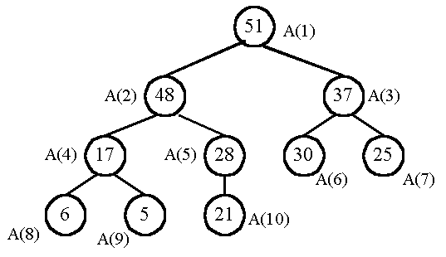
Heap sort—An optimal sorting algorithm
Max Heap: Each node is no less than its children

Slide 50
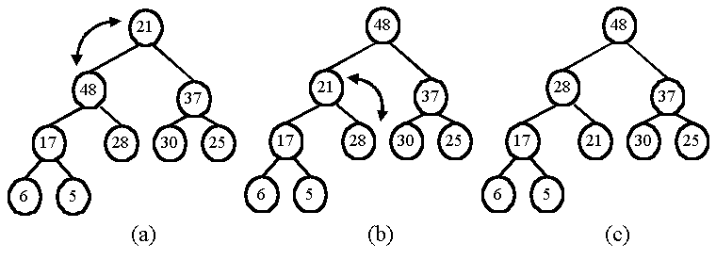
output the maximum and adjust the tree:

Slide 51
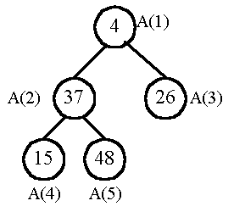
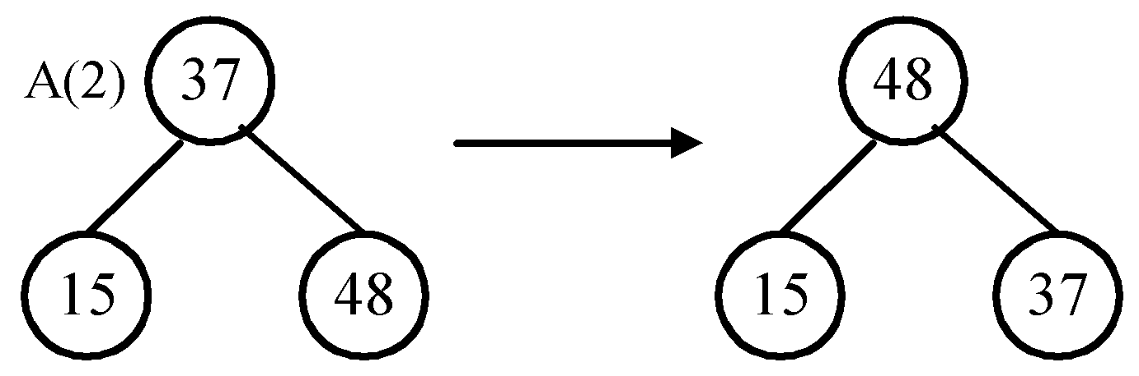
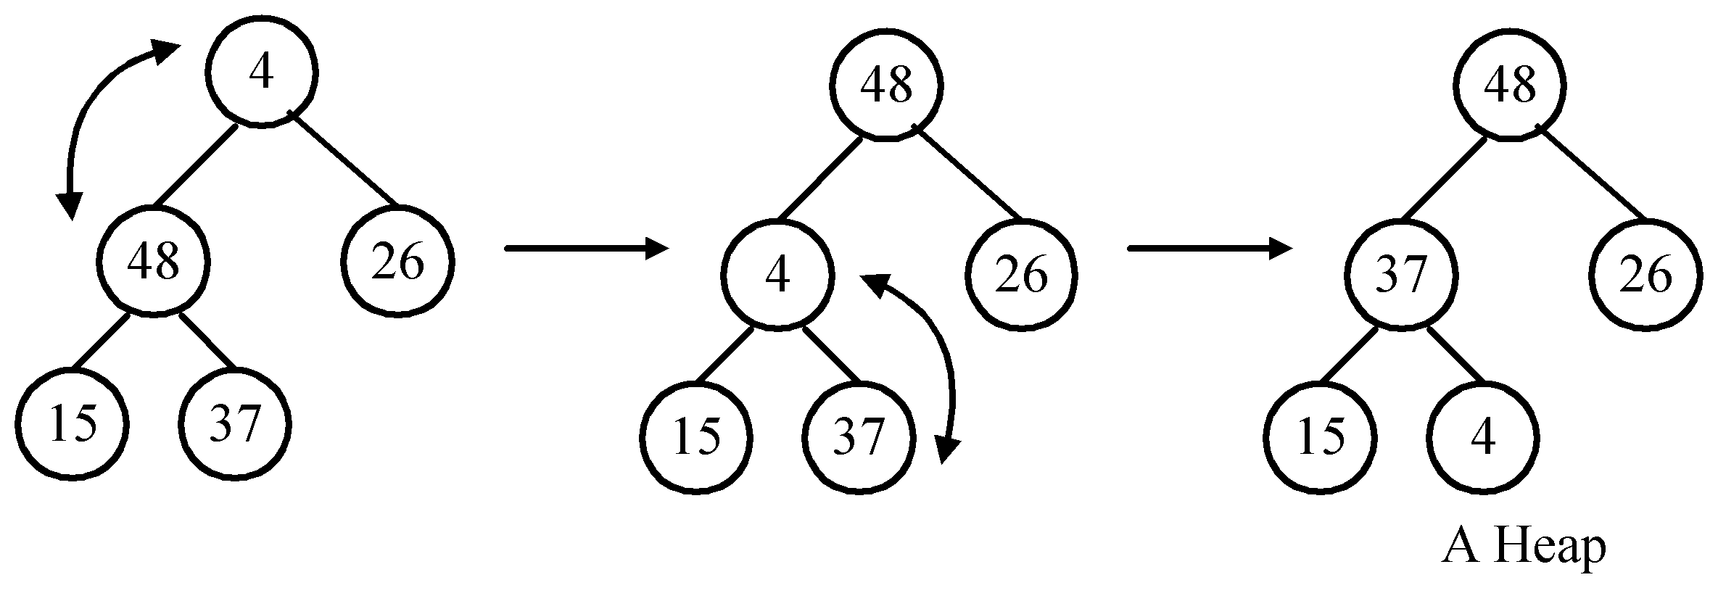
Phase 1: construction
Input data: 4, 37, 26, 15, 48
Adjust the subtree rooted at A(2):
Adjust the tree rooted at A(1):

Slide 52
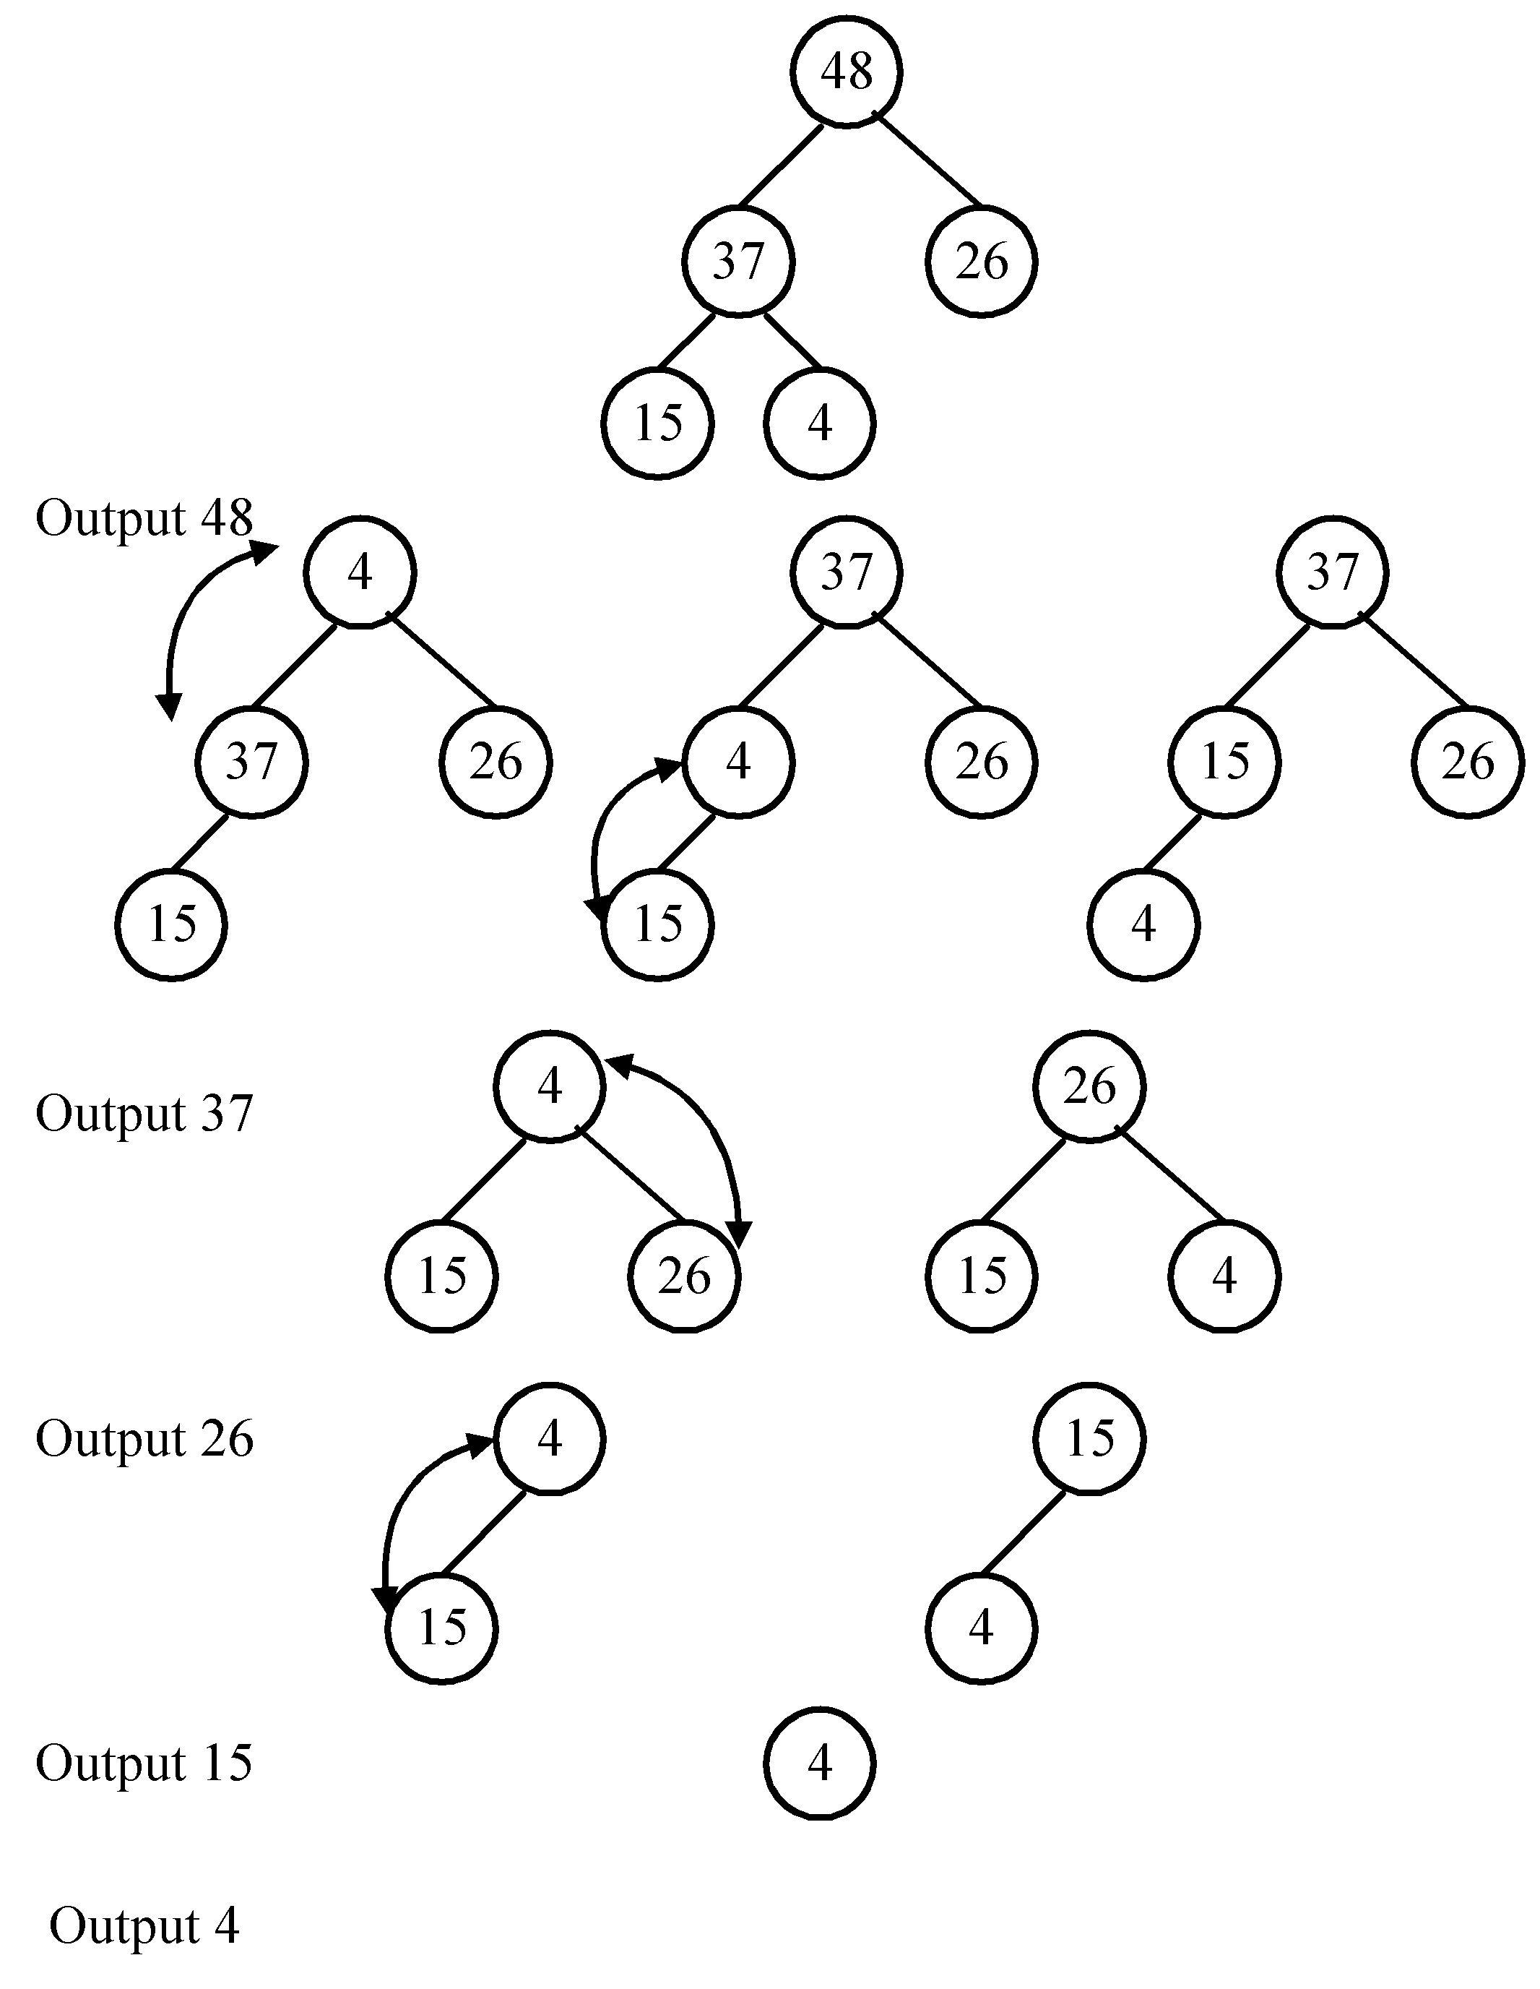
Phase 2: output

Slide 53
Implementation
To represent a binary heap tree, we use a linear array rather than a linked list.
Key observation: The children of A(i) are A(2i) and A(2i+1), and the parents of A(i) is .
Time complexity = O(n log n)

Slide 54
Time complexity Phase 1: construction
External nodes (leaves) do not require any reconstruction
Each internal node requires two comparisons with its two children, in the worst case

Slide 55
Time complexity Phase 1: construction

Slide 56
Time complexity Phase 2: output

Slide 57
Average case lower bound of sorting

Slide 58
Average case lower bound of sorting
By binary decision tree
The average time complexity of a sorting algorithm can be explored using the external path length of the binary tree
The external path length is minimized if the tree is balanced

Slide 59
Average case lower bound of sorting

Slide 60
Compute the min external path length
1. Depth of balanced binary tree with c leaf nodes:
d = ⎡log c⎤
Leaf nodes can appear only on level d or d−1.
2. x₁ leaf nodes on level d−1
x₂ leaf nodes on level d
x₁ + x₂ = c
x₁ + = 2^{d-1}
⇒ x₁ = 2^{d} −c
x₂ = 2(c − 2^{d-1})
x₁
x₂

Slide 61
3. External path length:
M = x₁(d − 1) + x₂d
= (2^{d} − c)(d − 1) + 2(c − 2^{d-1})d
= c(d − 1) + 2(c − 2^{d-1}), d − 1 = ⎣log c⎦
= c⎣log c⎦
4. c = n!
M = n!⎣log n!⎦
M/n! <= ⎣log n!⎦
= ⎣log n!⎦+k, 0 ≤ k ≤ 1
= Ω(n log n)
Average case lower bound of sorting: Ω(n log n)

Slide 62
Average-case and worst-case lower bounds of sorting: Ω(n log n)
Worst-case time complexity of heapsort is O(n log n)
Average case time complexities of heapsort and quick sort are O(n log n)
Heapsort and quick sort are optimal in the average case

Slide 63
Finding lower bound by problem transformation
Problem A reduces to problem B (A∝B)
iff A can be solved by using any algorithm which solves B.
If A∝B, B is at least as difficult as A
Note: T(tr₁) + T(tr₂) < T(B)
T(A) ≤ T(tr₁) + T(tr₂) + T(B) ∼ O(T(B))

Slide 64
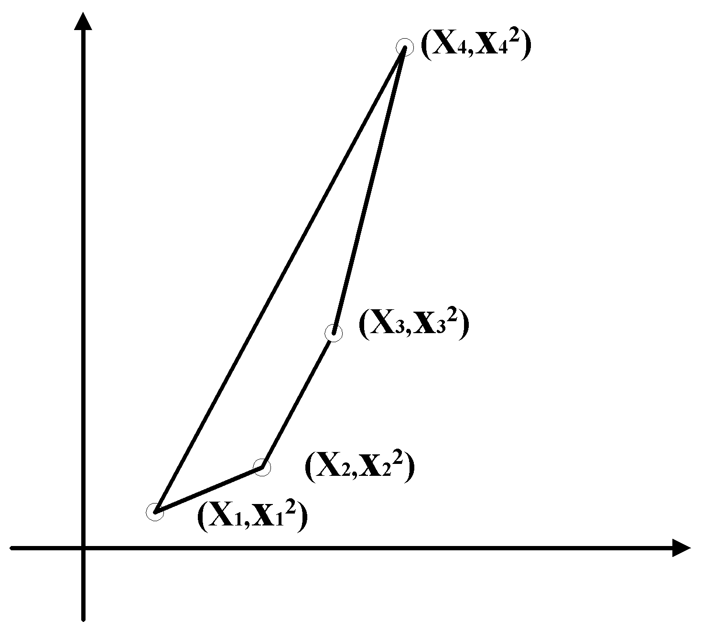
The lower bound of the convex hull problem
sorting ∝ convex hull
A B
an instance of A: (x₁, x₂,…, x_{n})
↓transformation
an instance of B: {( x₁, x₁²), ( x₂, x₂²),…, ( x_{n}, x_{n}²)}
assume: x₁ < x₂ < …< x_{n}

Slide 65
If the convex hull problem can be solved, we can also solve the sorting problem.
The lower bound of sorting: Ω(n log n)
The lower bound of the convex hull problem: Ω(n log n)

Slide 66
The lower bound of the Euclidean minimal spanning tree (MST) problem
sorting ∝ Euclidean MST
A B
an instance of A: (x₁, x₂,…, x_{n})
↓transformation
an instance of B: {( x₁, 0), ( x₂, 0),…, ( x_{n}, 0)}
Assume x₁ < x₂ < x₃ <⋅⋅⋅< x_{n}
⇔ there is an edge between (x_{i}, 0) and (x_{i+1}, 0) in the MST, where 1 ≤ i ≤ n−1

Slide 67
If the Euclidean MST problem can be solved, then we can also solve the sorting problem.
The lower bound of the Euclidean MST problem: Ω(n log n)

Slide 68
A Final Remark
Restrictions applied to
Input instances
Output
Minimum spanning tree
The edge weight is either 1 or 2
The derived spanning tree cannot has any node with degree > 2
Which restriction makes the MST problem more difficult to solve?

